Slide 1
ARIMA | Model ID

Slide 2
Model ID for ARIMA(p, d, q) Models
where
ϕ(B) and θ(B) are pth and qth order operators, respectively
All roots of ϕ(z) = 0 and θ(z) = 0 are outside the unit circle

Slide 3
Properties of ARIMA Models
Recall:
The (1−B)^{d} factor dominates the stationary components
In the realizations
Autocorrelations
Spectral densities (not shown) all have peaks at f = 0
For d >1 this domination is even more striking
The true autocorrelations are equal to one for all lags
The sample autocorrelations will always damp (in part because of the way they are calculated)
Slowly damping sample autocorrelations is an indication of an ARIMA data

Slide 4
Recall the Issues with Parameter Estimation in Stationary Models with Roots Close to the Unit Circle
Real root very close to unit circle
Factor Abs recip System freq
1-0.995B 0.9950 0.0
1-1.2B+0.8B² 0.8944 0.133
ϕ₁
ϕ₂
ϕ₃
True | 2.195 | –1.994 | .796
YW | 1.34 | –0.57 | .11
Burg | 2.12 | –1.90 | .75
MLE | 2.14 | –1.92 | .76
Burg and ML estimates are better than YW in near “nonstationary” case

Slide 5
Model ID in Nonstationary Case: General Comments
YW and Burg estimates always produce stationary AR models
Even if data are from an ARIMA model
ML estimates may produce nonstationary models
However, the nonstationarity is often due to roots inside the unit circle rather than on the unit circle like (1-B).
i.e. unacceptable models

Slide 6
Key Point
A decision whether to fit a stationary or nonstationary model must be made by the time series analyst
Simply noting that a fitted model has roots outside the unit circle does not in itself indicate stationarity
The decision whether to fit a nonstationary model may depend on the physical problem being considered
For example, data from stationary models have an attraction to a mean value.
Is this a reasonable assumption for your data?

Slide 8
ARIMA | Dow Jones Example Part 1

Slide 9
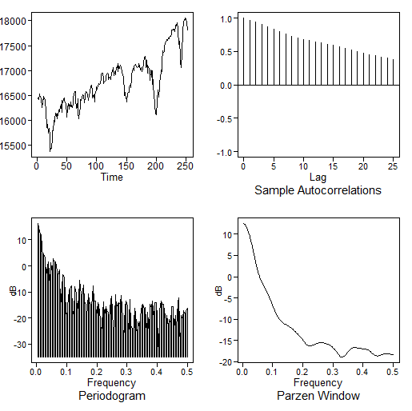
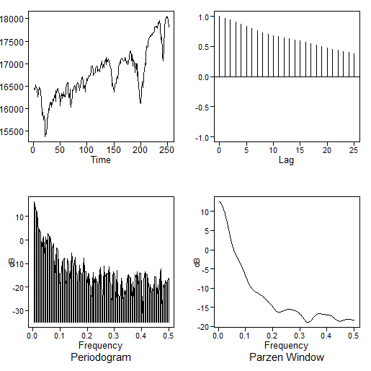
Dow Jones Data
The graphs below are
A plot of daily closing values of the DOW Jones for 2014
The associated (damping) sample autocorrelations
DOW Jones 2014
Sample autocorrelations

Slide 10

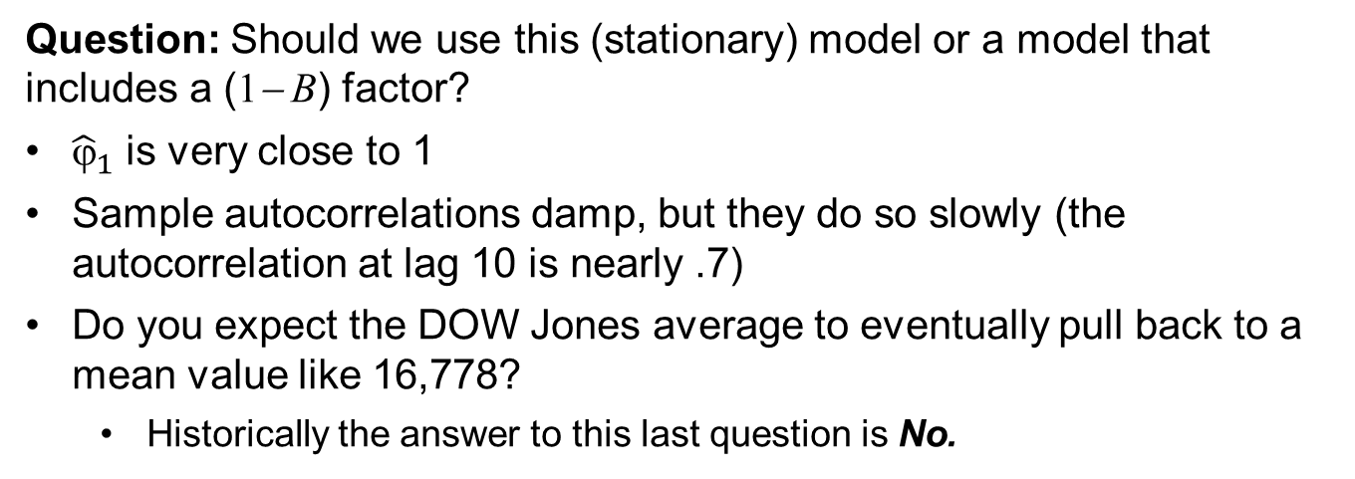
Dow Jones Data
The tswge commands:
data(dowjones2014)
aic.wge(dowjones2014,p=0:5,q=0:2)
select the AR(1) model:
$(1−.9816B)(X_{t}−$16778) = $a_{t}$
Question: Should we use this (stationary) model or a model that includes a (1− B) factor?
${\hat{ϕ}}_{1}$ is very close to 1
Sample autocorrelations damp, but they do so slowly (the autocorrelation at lag 10 is nearly .7)
Do you expect the DOW Jones average to eventually pull back to a mean value like 16,778?
Historically the answer to this last question is No.
A nonstationary model is suggested

Slide 12
ARIMA Box-Jenkins Model ID Procedure

Slide 13
Classical Box-Jenkins Procedure* for Including a Unit Root in the Model
If data are wandering and sample autocorrelations damp slowly
Difference the data
If differenced data still show evidence of a unit root
Difference the data again, etc.
* Reference to “Box-Jenkins” procedures apply to techniques proposed in the Classic Box-Jenkins (1970) text on time series analysis. These include
The forecasting procedure we used
The stationary model ID procedure we do not recommend
The nonstationary differencing techniques listed above

Slide 14
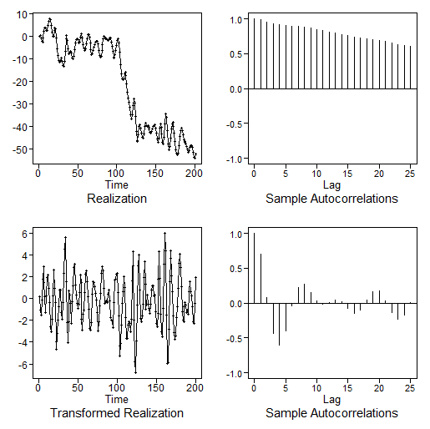
A Model with a Unit Root
Original data
Sample autocorrelations
Nonstationary-like behavior
Sample autocorrelations of differenced data
Cyclic stationary behavior
Differenced data

Slide 15
Steps for Obtaining an ARIMA(p,d,q) Model
Difference the data (possibly multiple times) until the data appear stationary
Estimate the parameters of the “stationarized data”

Slide 17
Example 1
1 Unit Root

Slide 18
Model with a Unit Root
Original data
Sample autocorrelations
Notes:
We decided to difference the data because
Dramatic wandering
Slowly damping autocorrelations
Differencing the data adds a factor of (1−B) to the final model of the original data (which will be ARIMA)
A feasible decision might also have been to go ahead and model the data using a stationary model
i.e. fit a model (using AIC) to the original data
# generate ARIMA(2,1,0) data
xd1=gen.arima.wge(n=200,phi=c(1.2,-.8),d=1,sn=56)
# difference the data
xd1.dif=artrans.wge(xd1,phi.tr=1)
# xd1.dif is the differenced data

Slide 19
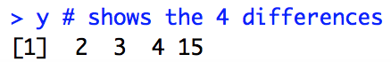
Review: “Difference” the Data using tswge
tswge transformation function
# the following command differences the data in x
y=artrans.wge(x,phi.tr=1)
# This simply means that y(i) = x(i) – x(i-1)
# y has length n-1 because x(1) has no x(0) before it.
# Example
x = c(1,3,6,10,25)
y = artrans.wge(x,phi.tr = 1)
y # shows the 4 differences

Slide 20
Model with a Unit Root
Original data
Sample autocorrelations
# generate ARIMA(2,1,0) data
xd1=gen.arima.wge(n=200,phi=c(1.2,-.8),d=1,sn=56)
# difference the data
xd1.dif=artrans.wge(xd1,phi.tr=1)
# xd1.dif is the differenced data
Sample autocorrelations of differenced data
Differenced data

Slide 21
Model with a Unit Root
Differenced data
Sample autocorrelations of differenced data
Differenced data (xd1.dif) appear stationary—use AIC
aic5.wge(xd1.dif,p=0:5,q=0:2)
# aic picks AR(2)
est.ar.wge(xd1.dif,p=2) # $phi [1] 1.265005 -0.802240
# $avar [1] 0.9293244
mean(xd1) # -21.22
Final model

Slide 22
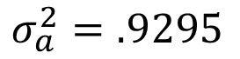
Or … We Could Have Modelled it with a Stationary Model
Original data
Sample autocorrelations
# generate ARIMA(2,1,0) data
x=gen.arima.wge(n=200,phi=c(1.2,-.8),d=1,sn=56)
# Assume it will eventually make it back to a fixed
# process mean. That is, it is attracted to a constant mean.
aic5.wge(x) # selects a p = 4, q = 0
est.arma.wge(x, p = 4, q = 0)
#phis: 2.3546329 -2.2920782 1.0456011 -0.1101713
#avar: 0.9295115
mean(x) #-21.21951
$$\left(1−2.35B+2.29B2 − 1.05B3+0.11B4\right){(X}_{t}+21.22) = a_{t}$$
$$σ_{a}^{2}=.9295$$

Slide 24
Example 2
2 Unit Roots

Slide 25
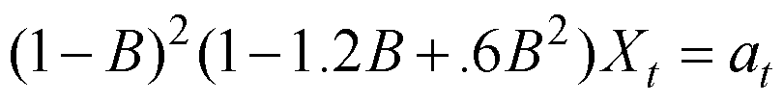
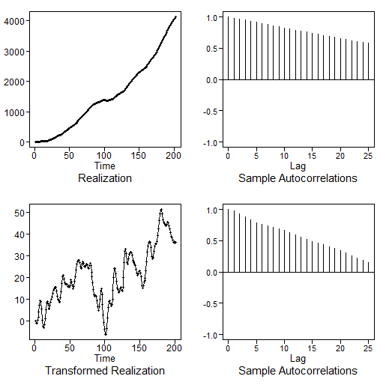
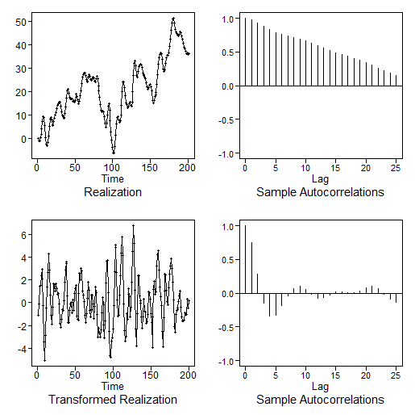
A Model with 2 Unit Roots
Original data
Sample autocorrelations
Nonstationary: no stationary AR(2) behavior visible
Sample autocorrelations of differenced data
Differenced data
Nonstationary: stationary AR(2) behavior not obvious
Twice differenced data
Sample autocorrelations of twice differenced data
Stationary AR(2) behavior can now be seen

Slide 26
tswge demo
# generate data from the ARIMA(2,2,0) model
x=gen.arima.wge(n=200,d=2,phi=c(1.2,-.6),sn=132,vara=1)
# difference the data
x.d1=artrans.wge(x,phi.tr=1)
# difference the data again since the differenced data
# still has nonstationary ARIMA characteristics
# (see previous slide)
x.d2=artrans.wge(x.d1,phi.tr=1)
# x.d2 appears to be stationary (see previous slide)
aic5.wge(x.d2,p=0:5,q=0:2)
# AIC picks an AR(2) # which seems reasonable from
est.ar.wge(x.d2,p=2)
# $phi[1] 1.2724446 -0.6827008
# $avar [1] 1.026015
mean(x) # 1512
Final model

Slide 28
Comments about ARIMA Models

Slide 29
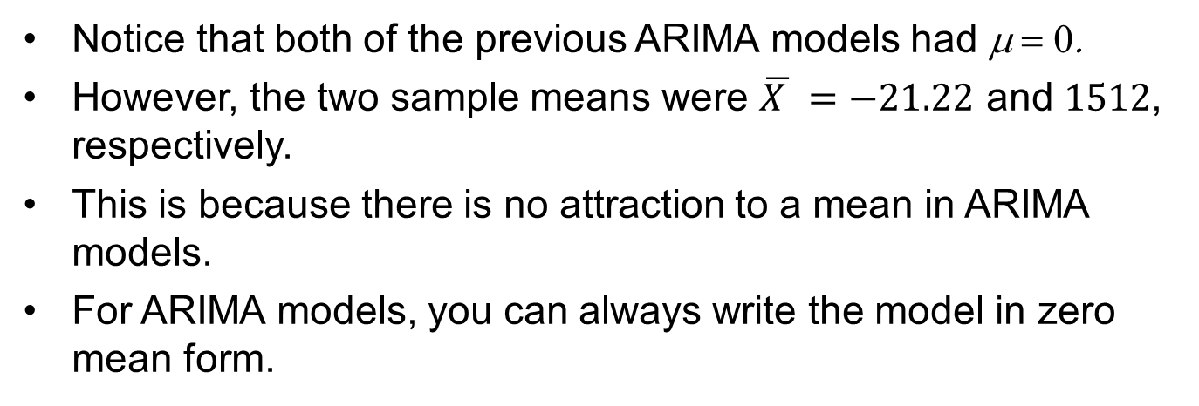
Comments about ARIMA Models
Notice that both of the previous ARIMA models had μ = 0.
However, the two sample means were $\overline{X }=−21.22$ and 1512, respectively.
This is because there is no attraction to a mean in ARIMA models.
For ARIMA models, you can always write the model in zero mean form.

Slide 31
Review of Forecasts for ARIMA Models

Slide 32
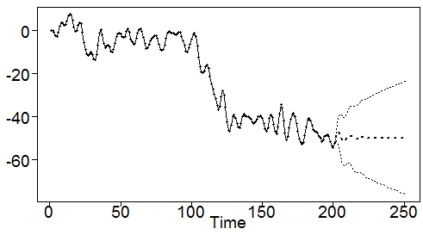
Forecasting with the ARIMA(2,1,0) Model
Fitted model
tswge forecasting code
# let xd1 denote the realization that produced
# this model fit
# code for forecasting the next 50 values
fore.aruma.wge(xd1,d=1,phi=c(1.27,-.8),n.ahead=50)
Forecasts essentially forecast the last data value (because of a singe (1−B) factor). The AR(2) factor adds a little cyclic behavior for early steps ahead.

Slide 33
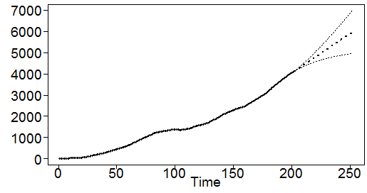
Forecasting with the ARIMA(2,2,0) Model
Fitted model
tswge forecasting code
# let x denote the realization that produced
# this model fit
# code for forecasting the next 50 values
fore.aruma.wge(x,d=2,phi=c(1.27,-.68),n.ahead=50)
Forecasts essentially forecast a linear trend determined by the last two data values. The effect of the AR(2) is not noticeable.

Slide 35
ARIMA | Dow Jones Example Part 2

Slide 36
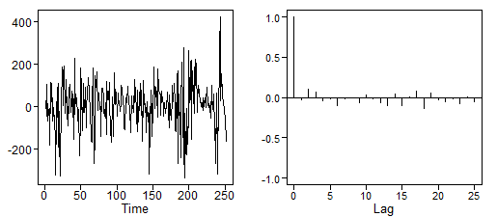
2014 DOW Jones Data
DOW Jones 2014
Sample autocorrelations
Nonstationary-like behavior
Sample autocorrelations of differenced data
Differenced DOW data
Looks stationary

Slide 37
2014 DOW Jones Data
tswge code for differencing and analyzing the differenced data
data(dowjones2014)
# redefine for simplicity
dow=dowjones2014
# difference the data
dow.1=artrans.wge(dow,phi.tr=1)
aic5.wge(dow.1,p=0:5,q=0:2)
# aic picks ARMA(4,1)
est.arma.wge(dow.1,p=4,q=1)
# $phi [1] 0.9265955 0.1355600 -0.0240474 -0.1242563
# $theta [1] 0.9999996
# $avar [1] 12112
mean(dow) # 16778

Slide 38
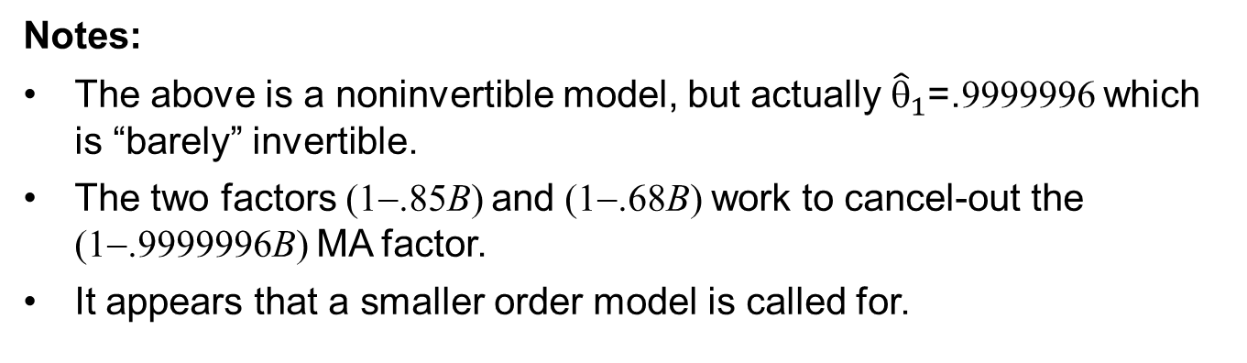
2014 DOW Jones Data
Let’s look at the estimated ARMA(4,1) model
which factors into the following factors found using
factor.wge(phi=c(.93,.14,-.02,-.12))
Notes:
The above is a noninvertible model, but actually ${\hat{θ}}_{1}$=.9999996 which is “barely” invertible.
The two factors (1−.85B) and (1−.68B) work to cancel-out the (1−.9999996B) MA factor.
It appears that a smaller order model is called for.

Slide 39
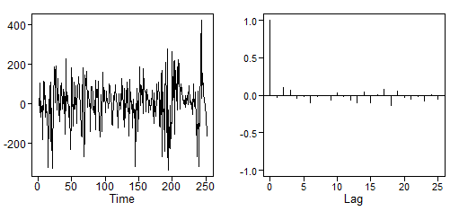
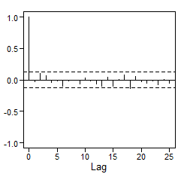
2014 DOW Jones Data
We try using BIC
aic5.wge(dow.1,p=0:5,q=0:2,type='bic')
# BIC selects p=0,q=0, i.e. white noise
Looking again at the differenced data we see that white noise is plausible.
Sample autocorrelations of differenced data
Differenced DOW data
We should have modeled it as white noise before applying AIC!

Slide 40
2014 DOW Jones Data
Final model
So, we can write the model without the mean.
Note:
This is true for all ARIMA models with d ≥ 1
We could have written the final models for the ARIMA(2,1,0) and ARIMA(2,2,0) examples without a mean.

Slide 41
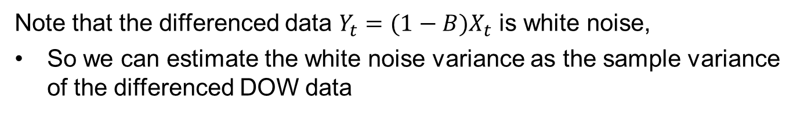
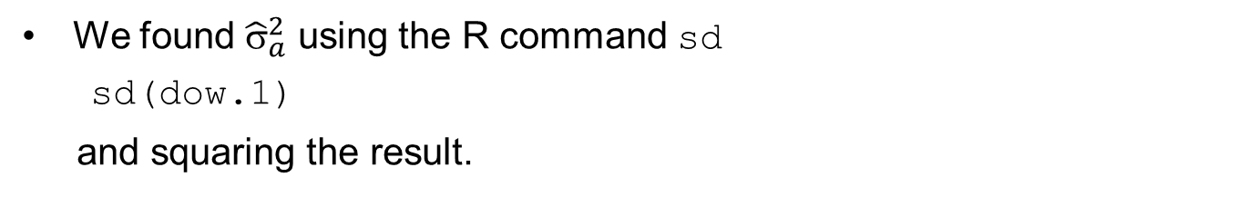
2014 DOW Jones Data
DOW Jones model
Note that the differenced data $Y_{t}=(1−B)X_{t}$ is white noise,
So we can estimate the white noise variance as the sample variance of the differenced DOW data
We found ${\hat{σ}}_{a}^{2}$ using the R command sd
sd(dow.1)
and squaring the result.
Final model
DOW Jones
Note:
Forecasts from this model will simply repeat the last data value for all steps ahead
It’s difficult to predict the DOW!

Slide 43
A More General Approach to ARIMA Model ID

Slide 44
A More General Approach for Detecting Nonstationarities
To this point, our approach (Box-Jenkins) for detecting and removing stationarities is as follows:
If data are wandering and sample autocorrelations damp slowly
Difference the data
If differenced data still show evidence of a unit root
Difference the data again, etc.

Slide 45
A More General Approach for Detecting Nonstationarities
The ARIMA is an extension of the ARMA model to allow one or more factors of (1−B) in the model
That is, ARIMA models include roots on the unit circle
For ARIMA models, these roots are +1
ARIMA models are not the only extension of ARMA models that have roots on the unit circle
These roots may be complex. These models include
Seasonal models
Cyclic ARUMA models (see Woodward, et al., 2017; but not covered here)

Slide 47
Tiao/Tsay and Overfit Tables
1 Unit Root

Slide 48
Result (Tiao/Tsay) (loosely stated):
If a high order AR(p) model is fit to a realization from a nonstationary model with roots on the unit circle, then factors associated with these roots will “show up” in the factor table.
The nonstationary behavior will “show up” in factor tables for a wide range of orders p.
Fitting several high order models to a set of data to identify nonstationarities is called overfitting.
Overfitting using the tswge package:
est.ar.wge function
We use Burg estimates (always stationary)
MLE would be ok

Slide 49
Recall: ARIMA(2,1,0) Model
Original data
Sample autocorrelations
# generate ARIMA(2,1,0) data as before
xd1=gen.arima.wge(n=200,phi=c(1.2,-.8),d=1,sn=56)
# fit an AR(6) and AR(8) to this realization
est.ar.wge(xd1,p=6,type='burg')
est.ar.wge(xd1,p=8,type='burg')

Slide 50
Overfit Tables for ARIMA(2,1,0) Data
AR(6) fit
Absolute reciprocal of root
System frequency (f₀)
AR factor
1-0.9944B 0.9944 0.0000
1-1.1978B+0.7584B^2 0.8708 0.1293
1-0.4472B+0.0881B^2 0.2967 0.1142
1+0.2879B 0.2879 0.5000
AR(8) fit
1-0.9951B 0.9951 0.0000
1-1.1324B+0.7314B^2 0.8552 0.1348
1-1.0807B+0.4241B^2 0.6513 0.0943
1+0.4968B 0.4968 0.5000
1+0.3615B+0.2464B^2 0.4964 0.3093
Key point:
Even though the data are not from an AR(6) or AR(8), the factor close to 1-B shows up in both factor tables

Slide 51
Recall for ARIMA(2,1,0) Data
We previously analyzed these data and we decided to difference the data because:
The data are wandering and sample autocorrelations damp slowly.
We only differenced once because the differenced data appeared to be stationary.
Using overfitting:
We decide to difference the data because the near 1-B factor continued to show up in high order Burg overfits.
The differenced data will likely appear to be stationary after differencing because only one factor near 1-B appears in the overfit tables.

Slide 52
Modeling the ARIMA(2,1,0) Data using Overfitting
Since the factor tables suggest a factor of (1−B), we difference the data and come up with the same model as before:
Note:
As mentioned with the DOW data, we can write the model without a mean, i.e.
Question:
How do you use overfitting to detect more than one unit root?

Slide 54
Overfit Factor Tables
2 Unit Roots

Slide 55
Question:
How do you use overfitting to detect more than one unit root?

Slide 56
A Model with 2 Unit Roots
Original data
Sample autocorrelations
# generate ARIMA(2,2,0) data as before
x=gen.arima.wge(n=200,d=2,phi=c(1.2,-.6),sn=132)
# fit an AR(8) and AR(10) to this realization
est.ar.wge(x,p=8,type='burg')
est.ar.wge(x,p=10,type='burg')

Slide 57
Overfit Tables for ARIMA(2,2,0) Data
AR(8) fit
Factor Abs recip System freq
1-1.9919B+0.9924B^2 0.9962 0.0036
1-1.2575B+0.6987B^2 0.8359 0.1145
1-0.8229B 0.8229 0.0000
1+0.1891B+0.2798B^2 0.5290 0.2786
1+0.4792B 0.4792 0.5000
AR(10) fit
1-1.9903B+0.9909B^2 0.9954 0.0036
1-0.8684B 0.8684 0.0000
1-1.3414B+0.7528B^2 0.8676 0.1094
1-0.1407B+0.4330B^2 0.6581 0.2330
1+1.0699B+0.4040B^2 0.6356 0.4092
1-0.1267B 0.1267 0.0000

Slide 58
No Factors near 1-B ?
Let’s examine AR(8) fit further
Factor Abs recip System freq
1-1.9919B+0.9924B^2 0.9962 0.0036
This factor
Has roots very close to the unit circle
Has System Frequency f₀ =.0036
Associated with period 1/.0036 = 278
This period is longer than the data length (n = 200)
Suggests aperiodic data or data with a very long period
Is very close to 1−2B+B² = (1−B)²
Suggests two factors of (1−B)
Note: AR(10) fit has a similar factor

Slide 59
Recall for ARIMA(2,2,0) Data
We previously analyzed these data and we decided to difference the data twice.
Using overfitting:
We decide to difference the data twice because of the comments on the previous slide.
We come up with the same final model as in our previous analysis of this realization.
Note: We did this analysis by looking at factor tables.
It is always a good idea to look at the data
Before and after differencing, etc.

Slide 61
ARIMA | Comments about Unit Roots

Slide 62
Comments about Unit Roots (ARIMA Models)
We mentioned that the decision whether to include a unit root or other nonstationary component in your model is a difficult one.
We argued that it is a conscious decision that must be made by you.
We next discuss the “Dicky-Fuller tests” which are popular in Economics.
These tests are appealing because they seem to “make this decision for you.”

Slide 64
Dicky-Fuller Test

Slide 65
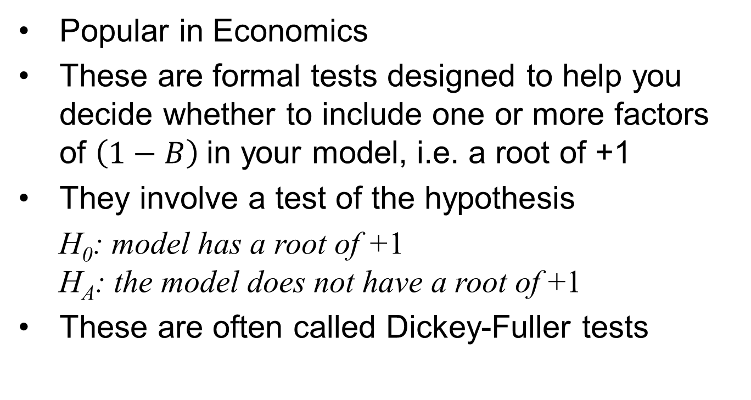
Testing for Unit Roots
Popular in Economics
These are formal tests designed to help you decide whether to include one or more factors of $\left(1−B\right)$in your model, i.e. a root of +1
They involve a test of the hypothesis
H₀: model has a root of +1 H_{A}: the model does not have a root of +1
These are often called Dickey-Fuller tests

Slide 66
A Problem with the Dicky-Fuller Tests
A problem with these tests is that a decision to include a unit root in the model is based on a decision to not reject the null hypothesis!
As data scientists you know that failure to reject a null hypothesis does not mean that it is true!
The following mini-simulation will illustrate this point
Using function adf.test in CRAN package tseries

Slide 67
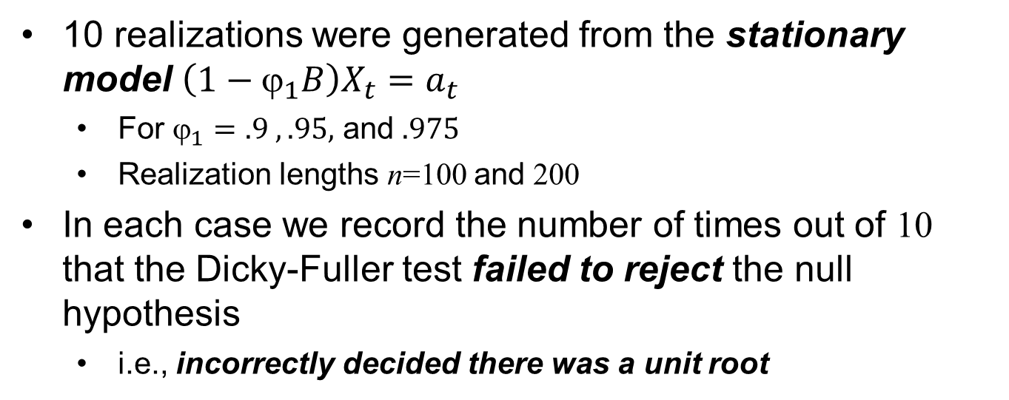
Mini-Simulation
10 realizations were generated from the stationary model $\left(1−ϕ_{1}B\right)X_{t}=a_{t}$
For $_{1}=.9 , .95,$ and $.975$
Realization lengths n=100 and 200
In each case we record the number of times out of 10 that the Dicky-Fuller test failed to reject the null hypothesis
i.e., incorrectly decided there was a unit root
$$_{1}=.9 _{1}=.95 _{1}=.975$$
n=100 9/10 9/10 10/10
n=200 5/10 6/10 8/10

Slide 68
Comments on Simulation Results
The simulations show that unit root tests do not give you a definitive decision concerning whether a root is:
On the unit circle (nonstationary)
or
Close to the unit circle (stationary)
Bottom line:
The decision to include a nonstationary factor in your model must be made by you
And will often involve physical considerations/domain knowledge

Slide 70
Model ID for Strictly Seasonal Models

Slide 71
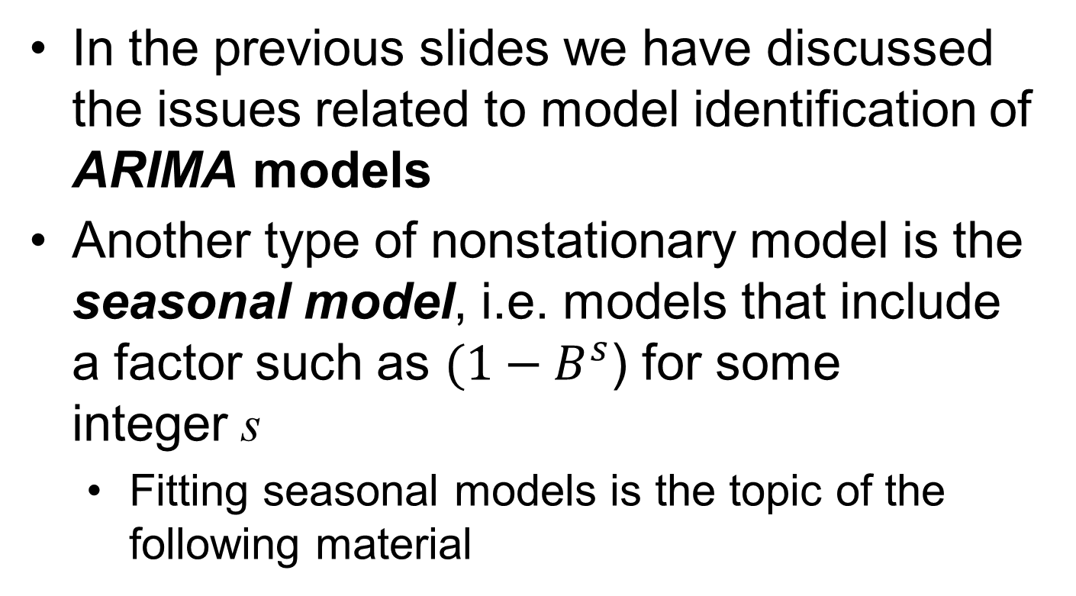
Model Identification for Seasonal Models
In the previous slides we have discussed the issues related to model identification of ARIMA models
Another type of nonstationary model is the seasonal model, i.e. models that include a factor such as $(1−B^{s}$) for some integer s
Fitting seasonal models is the topic of the following material

Slide 72
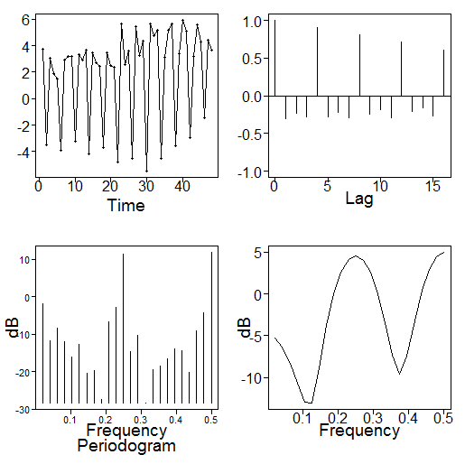
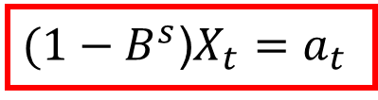
Recall: Seasonal Models
Pure seasonal models
$(1−B^{s}$)$X_{t}=a_{t}$
Example:
Realization
Sample autocorrelations
The data go through 20 “irregular periods of 4” in 80 time points. The pattern seems to be 3 values “high” followed by a very low value.
Sample autocorrelations at lags 4, 8, … are ”large” which is consistent with the model.
that is, X_{t}, X_{t+4}, X_{t+8}, … would be expected to be “similar”

Slide 73
Model Identification for Seasonal Models
Procedure for including 1 – B^{s} in the model
As in the case of ARIMA models, the decision to include a seasonal factor in the model is one you will have to make after considering the evidence.
Look at the data
Does the behavior in realization tend to repeat every s time periods?
Are the sample autocorrelations large at s, 2s, 3s, etc.?
Does a seasonal model with season s make sense?
We recommend using factor tables
Compare factors in overfit factor table with those for 1 – B^{s} under consideration.
If “nonstationary” factors match with factors of 1 – B^{s} fairly well, transform the data by 1 – B^{s}.

Slide 74
Recall: Seasonal Factor Table, s = 4
Factor Abs recip System freq
1-B 1 0.0
1+B 1 0.5
1+B^2 1 0.25
Factor table for seasonal data on previous slide
x=gen.aruma.wge(n=48,s=4,sn=23)
est.ar.wge(x,p=8,type='burg')
Factor Abs recip System freq
1+0.0148B+0.9826B^2 0.9912 0.2512
1+0.9905B 0.9905 0.5000
1-0.9556B 0.9556 0.0000
1-0.5126B+0.2985B^2 0.5464 0.1723
1+0.4753B 0.4753 0.5000
1+0.0593B 0.0593 0.5000
Factor tables with p=10 and p=12 are similar

Slide 75
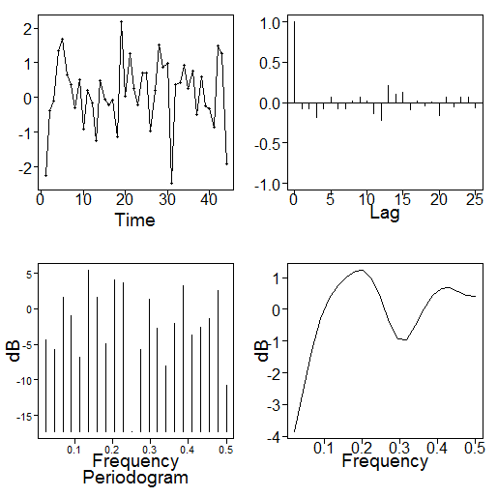
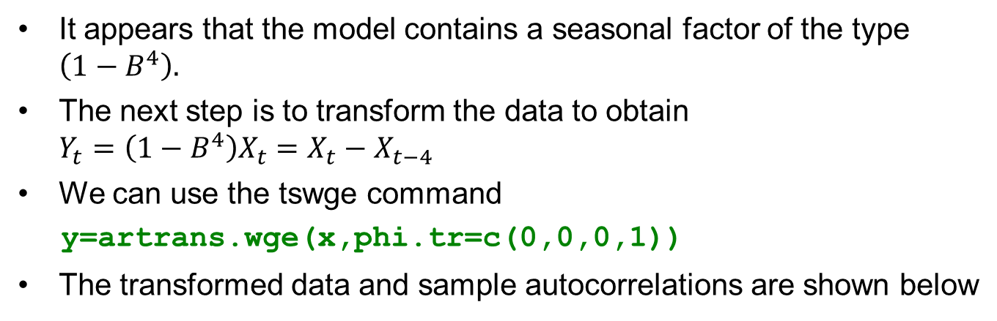
Based on the Factor Tables
It appears that the model contains a seasonal factor of the type $\left(1−B^{4}\right).$
The next step is to transform the data to obtain $Y_{t}=\left(1−B^{4}\right)X_{t}=X_{t}−X_{t−4}$
We can use the tswge command
y=artrans.wge(x,phi.tr=c(0,0,0,1))
The transformed data and sample autocorrelations are shown below
The next step is to model the transformed data

Slide 76
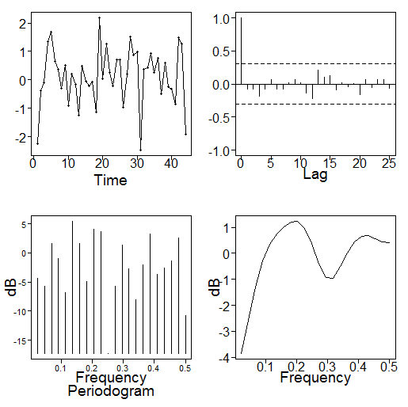
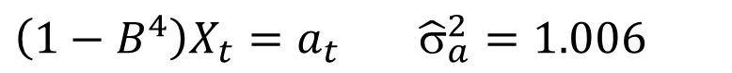
Finding a Final Model
Transformed data $Y_{t}=\left(1−B^{4}\right)X_{t}=X_{t}−X_{t−4}$
The transformed data appear white
Which is consistent with the true model
So the y variable obtained using artrans.wge is white noise. To find the white noise variance we use
wnv=sd(y)^2
Final model
$\left(1−B^{4}\right)X_{t}=a_{t}$ ${\hat{σ}}_{a}^{2}=1.006$

Slide 78
Model ID for More General Seasonal Models

Slide 79
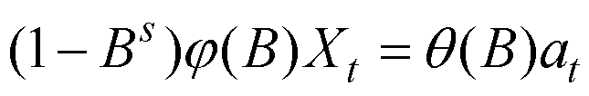
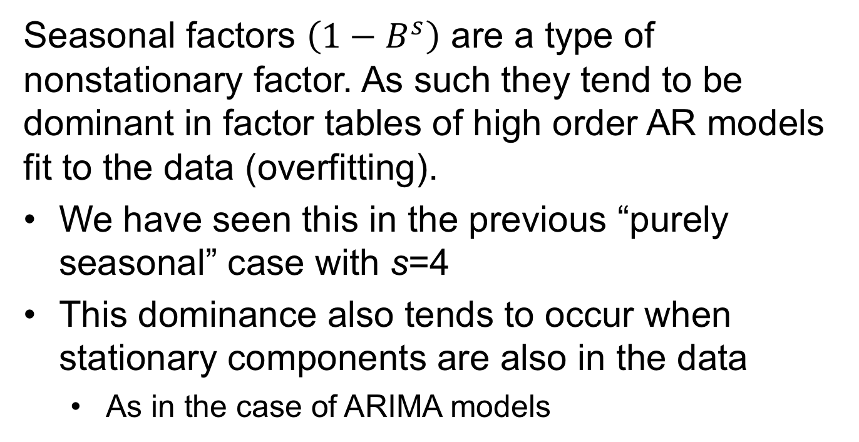
Fitting More General Seasonal Models
Seasonal factors $\left(1−B^{s}\right)$ are a type of nonstationary factor. As such they tend to be dominant in factor tables of high order AR models fit to the data (overfitting).
We have seen this in the previous “purely seasonal” case with s=4
This dominance also tends to occur when stationary components are also in the data
As in the case of ARIMA models

Slide 80
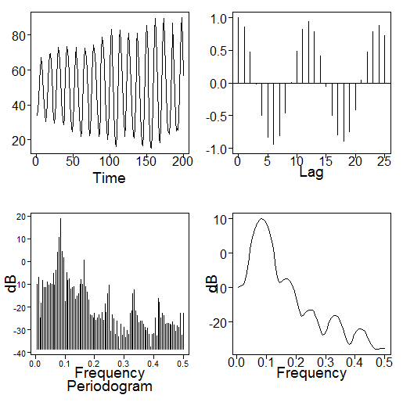

Simulated Seasonal Data
$$(1−B^{12})\left(1−1.5B+.8B^{2}\right)\left(X_{t}−50\right)=a_{t}$$
Realization
Sample autocorrelation
Use tswge to simulate and plot the data above
x=gen.aruma.wge(n=200,s=12,phi=c(1.5,-.8),sn=87)
x=x+50
plotts.sample.wge(x,lag.max=60)
d15=est.ar.wge(x,p=15, type='burg')

Slide 81
Factor table for $(1−B^{12})$
Factor Abs recip System freq
1+B+B^2 1 0.3333
1+1.732B+B^2 1 0.4167
1-B+B^2 1 0.1667
1+B 1 0.5000
1-1.732B+B^2 1 0.0833
1-B 1 0.0000
1+B^2 1 0.2500
Factor table for AR(15) fit to data on previous slide
d15=est.ar.wge(x,p=15, type='burg')
Factor Abs recip System freq
1-1.7269B+0.9978B^2 0.9989 0.0839
1+1.0027B+0.9948B^2 0.9974 0.3338
1-1.0036B+0.9944B^2 0.9972 0.1661
1-0.0142B+0.9907B^2 0.9953 0.2489
1+1.7320B+0.9904B^2 0.9952 0.4180
1+0.9788B 0.9788 0.5000
1-0.9522B 0.9522 0.0000
1-1.5043B+0.7732B^2 0.8793 0.0867
1+0.1523B 0.1523 0.5000
Factor Abs Recip System Freq
1+B+B^2 1 0.3333
1+1.732B+B^2 1 0.4167
1-B+B^2 1 0.1667
1+B 1 0.5000
1-1.732B+B^2 1 0.0833
1-B 1 0.0000
1+B^2 1 0.2500

Slide 82
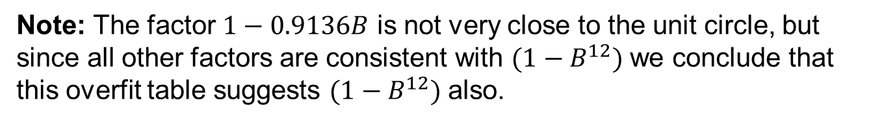
Factor Table for AR(17) Fit to Data on Previous Slide
d15=est.ar.wge(x,p=17, type='burg')
Factor Abs recip System freq
1-1.7276B+0.9985B^2 0.9992 0.0838
1-1.0028B+0.9955B^2 0.9977 0.1662
1+1.0010B+0.9936B^2 0.9968 0.3337
1-0.0157B+0.9930B^2 0.9965 0.2487
1+1.7329B+0.9899B^2 0.9949 0.4182
1+0.9836B 0.9836 0.5000
1-0.9136B 0.9136 0.0000
1-1.4286B+0.7747B^2 0.8802 0.0993
1-0.7137B 0.7137 0.0000
1+0.7516B+0.3366B^2 0.5801 0.3621
Note: The factor $1−0.9136B$ is not very close to the unit circle, but since all other factors are consistent with $(1−B^{12})$ we conclude that this overfit table suggests $(1−B^{12})$ also.

Slide 83
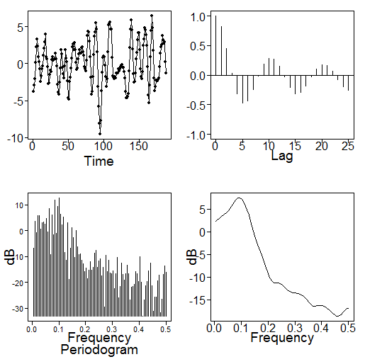
Based on Overfit Tables
y=artrans.wge(x,phi.tr=c(0,0,0,0,0,0,0,0,0,0,0,1))
Transformed data
Sample autocorrelations
The transformed data appear stationary, so we use AIC to identify a model.

Slide 84
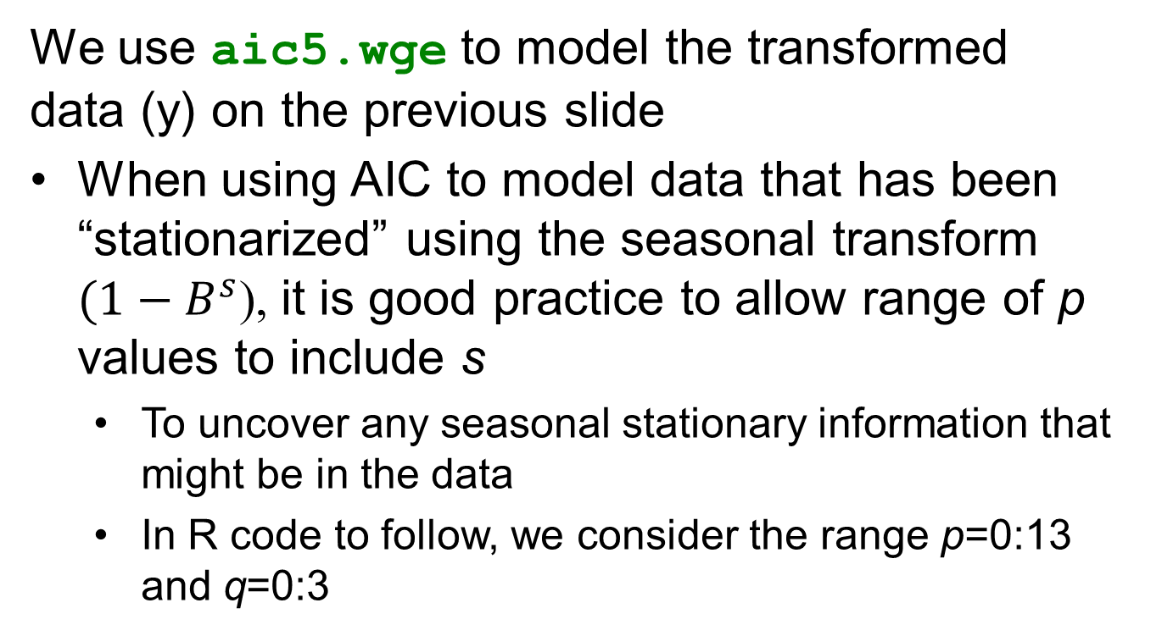
Using tswge to Model the Transformed Data
We use aic5.wge to model the transformed data (y) on the previous slide
When using AIC to model data that has been “stationarized” using the seasonal transform $(1−B^{s}$), it is good practice to allow range of p values to include s
To uncover any seasonal stationary information that might be in the data
In R code to follow, we consider the range p=0:13 and q=0:3

Slide 85
Using tswge to Model the Transformed Data
# y is the transformed data
aic5.wge(y,p=0:13,q=0:3)
AIC selects an ARMA(4,2) model. Factoring the ARMA(4,2) model we obtain:
AR factors
Factor Abs recip System freq
1-0.4098B+0.8135B^2 0.9019 0.2135
1-1.4733B+0.7771B^2 0.8815 0.0925
MA factor
Factor Abs recip System freq
1-0.4957B+0.9262B^2 0.9624 0.2085
Note: The dominant behavior of the transformed data is a pseudo cyclic behavior of length about 10 (f₀=.10). The factors associated with frequency about f₀=.2 essentially cancel.

Slide 86
Using tswge to Model the Transformed Data
Based on the comments on the previous slide, we look for a simpler model using BIC.
aic5.wge(y,p=0:13,q=0:3,type='bic')
BIC picks a simpler AR(2) model. This is consistent with
The pseudo cyclic data
Damping cyclical sample autocorrelations
Decision:
We choose to model the transformed data as an AR(2).

Slide 87
Final Model
Based on the decision to fit an AR(2) model, we use the est.ar.wge command to obtain ML estimates.
est.ar.wge(y,p=2)
# $phi: [1] 1.4652837 -0.7596714
# $avar: [1] 1.036377
mean(x) #[1] 49.77867
So, the final model is
$(1−B^{12})\left(1−1.47B+.76B^{2}\right)\left(X_{t}−49.78\right)=a_{t}$ ${\hat{σ}}_{a}^{2}=1.04$
which is very similar to the model from which the data were simulated:
$$\left(1−B^{12}\right)\left(1−1.5B+.8B^{2}\right)\left(X_{t}−50\right)=a_{t} σ_{a}^{2}=1$$

Slide 89
Review of Forecasting with Seasonal Models

Slide 90
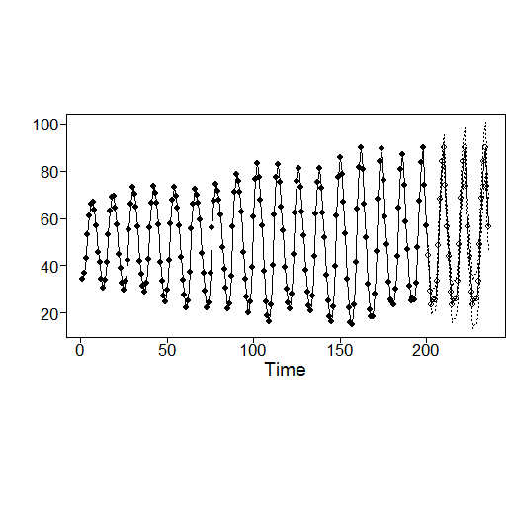
Forecasting with the Seasonal Model
$(1−B^{12})\left(1−1.47B+.76B^{2}\right)\left(X_{t}−49.78\right)=a_{t}$ ${\hat{σ}}_{a}^{2}=1.04$
Forecasts: 36 steps ahead
x=gen.aruma.wge(n=200,s=12,phi=c(1.5,-.8),sn=87)
x=x+50
fore.aruma.wge(x,s=12,phi=c(1.47,-.76),n.ahead=36,
lastn=FALSE)

Slide 91
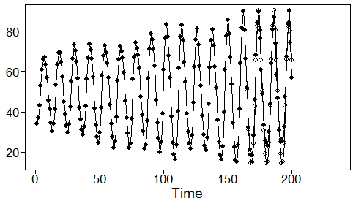
Forecasts: Last 36 Values
fore.aruma.wge(x,s=12,phi=c(1.47,-.76),n.ahead=36, lastn=TRUE,limits=FALSE)
ASE = 26.27
Summary:
The forecasts (open circles) are very close to the true values.
We were able to fit a model very close to the true model.
Forecasts (ahead and last 36) are quite good.

Slide 93
Seasonal Models | Example
Airline Data

Slide 94
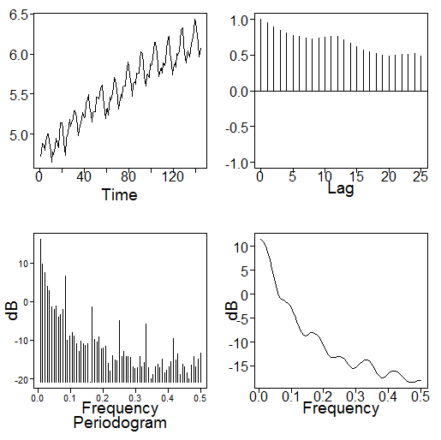
Example: Airline Data
Log airline data
Sample autocorrelations
Again
There is evidence of nonstationarity
We apply the overfit procedure using est.ar.wge

Slide 95
Factor table for $(1−B^{12})$
Factor Abs recip System freq
1+B+B^2 1 0.3333
1+1.732B+B^2 1 0.4167
1-B+B^2 1 0.1667
1+B 1 0.5000
1-1.732B+B^2 1 0.0833
1-B 1 0.0000
1+B^2 1 0.2500
?
Factor table for AR(15) fit to log airline data
est.ar.wge(lair,p=15,type='burg')
Factor Abs recip System freq
1-1.7253B+0.9953B^2 0.9976 0.0838
1-0.9861B+0.9950B^2 0.9975 0.1677
1+0.9869B+0.9850B^2 0.9925 0.3328
1-0.0375B+0.9788B^2 0.9893 0.2470
1-1.9697B+0.9704B^2 0.9851 0.0034
1+1.6891B+0.9504B^2 0.9749 0.4168
1+0.8540B 0.8540 0.5000
1+0.6000B 0.6000 0.5000
1-0.1110B 0.1110 0.0000
?

Slide 96
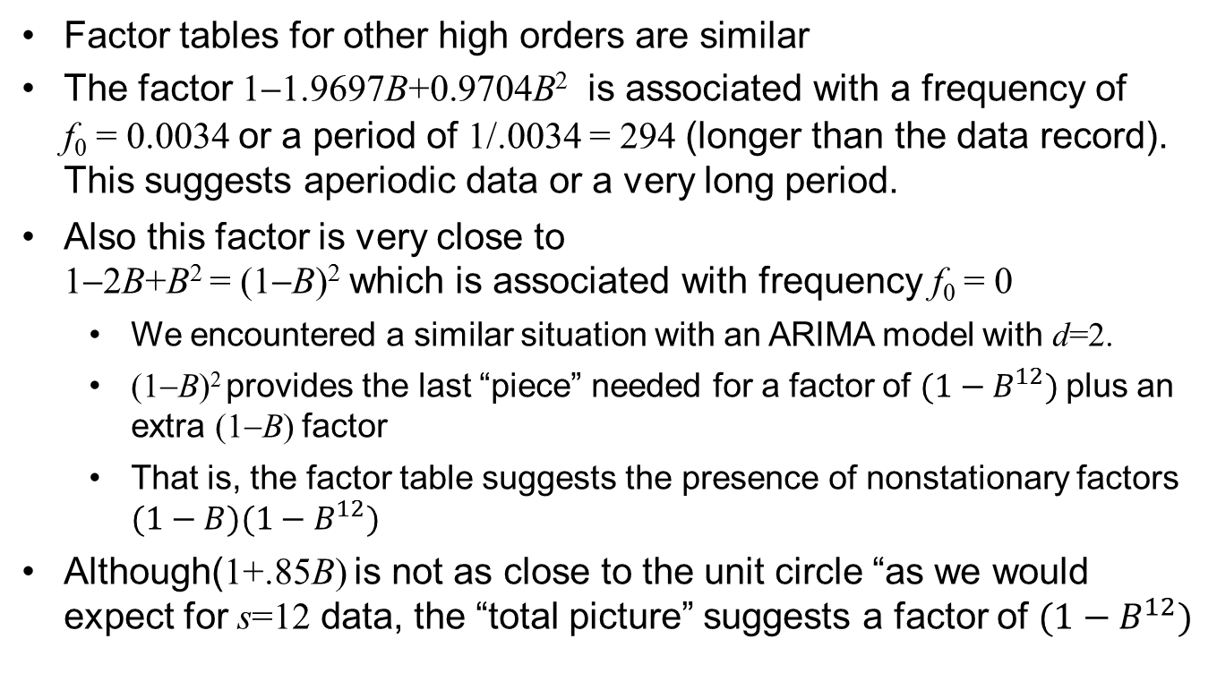
Notes
Factor tables for other high orders are similar
The factor 1−1.9697B+0.9704B² is associated with a frequency of f₀ = 0.0034 or a period of 1/.0034 = 294 (longer than the data record). This suggests aperiodic data or a very long period.
Also this factor is very close to 1−2B+B² = (1−B)² which is associated with frequency f₀ = 0
We encountered a similar situation with an ARIMA model with d=2.
(1−B)² provides the last “piece” needed for a factor of $(1−B^{12})$plus an extra (1−B) factor
That is, the factor table suggests the presence of nonstationary factors $(1−B)(1−B^{12})$
Although(1+.85B) is not as close to the unit circle “as we would expect for s=12 data, the “total picture” suggests a factor of $(1−B^{12})$

Slide 97
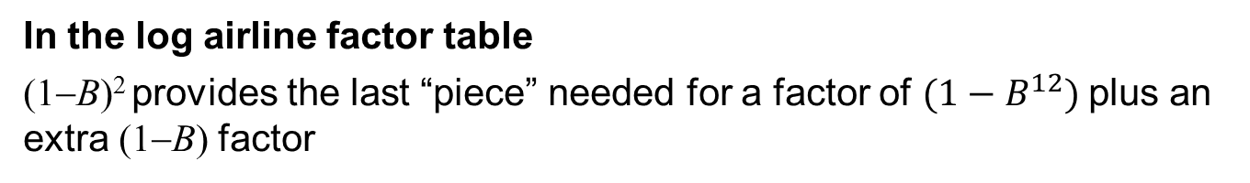

In the log airline factor table
(1−B)² provides the last “piece” needed for a factor of $(1−B^{12})$plus an extra (1−B) factor
Recall:
We earlier discussed the following model that is useful for modeling seasonal data with a trend
We referred to it as the airline model
For obvious reasons!
Note:
The airline model allows for stationary components
To find these, we transform to find $Y_{t}=\left(1−B\right)\left(1−B^{12}\right)X_{t}$

Slide 98
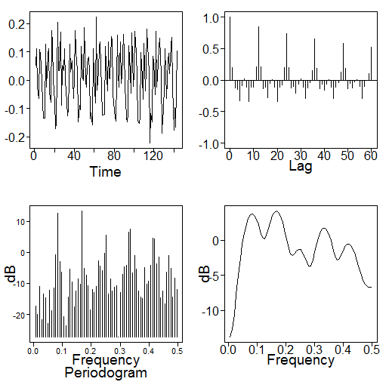
Transform to Stationarity
Using tswge to transform log airline data (lair) to remove seasonal and ARIMA components
#Difference the data
d1=artrans.wge(lair,phi.tr=1)
Differenced data (d1)
Sample autocorrelations
Trend has been removed
12 month seasonal behavior remains

Slide 99
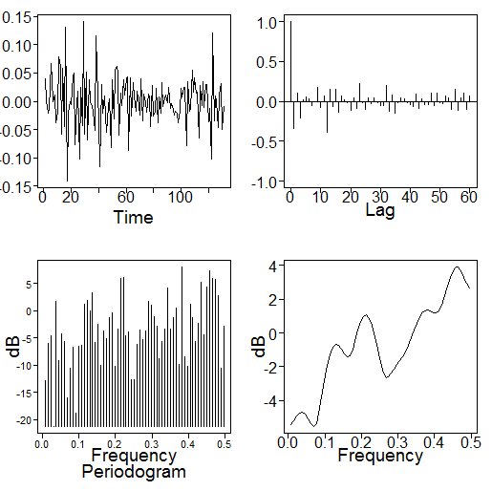
Differenced Data Transformed by (1-B¹²)
# Transform differenced data with “seasonal difference”
d1.12=artrans.wge(d1,phi.tr=c(0,0,0,0,0,0,0,0,0,0,0,1))
(1-B)(1-B¹²)X_{t} (d1.12)
Sample autocorrelations
Appears to be stationary
No trending or seasonality present
We will find a stationary model for this realization

Slide 100
Finding a Final Model for the (log) Airline Data
Use tswge to model the transformed data, d1.12
aic5.wge(d1.12,p=0:13,q=0:3)
AIC picks an ARMA(12,1).
In order to see if a lower order model could satisfactorily model the data, we use BIC
aic5.wge(d1.12,p=0:13,q=0:3,type='bic')
BIC picks an MA(1) as the first choice and an AR(1) as second choice.
Examining the data and sample autocorrelations, neither model seems appropriate
We decide to use the ARMA(12,1) model chosen by AIC

Slide 101
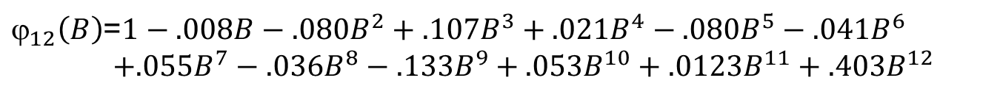
Final Model for (log) Airline Data
We estimate the parameters of the ARMA(12,1) model using est.arma.wge
est.arma.wge(d1.12,p=12,q=1)
# $phi [1] 0.00846435 0.07967002 -0.10710183 -0.02069279 0.08039524 0.04050674 -0.05516681 0.03629598 0.13277817
[10] -0.05297698 -0.12340975 -0.40343184
# $theta [1] 0.4536856
# $avar [1] 0.001310444
mean(lair) # [1] 5.542176
$\left(1−B\right)\left(1−B^{12}\right)ϕ_{12}\left(B\right)\left(X_{t}−5.54\right)=\left(1−.45B\right)a_{t}$ ${\hat{σ}}_{a}^{2}=.0013$
$_{12}\left(B\right)$=$1−.008B−.080B^{2}+.107B^{3}+.021B^{4}−.080B^{5}−.041B^{6}$ $+.055B^{7}−.036B^{8}−.133B^{9}+.053B^{10}+.0123B^{11}+.403B^{12}$

Slide 102
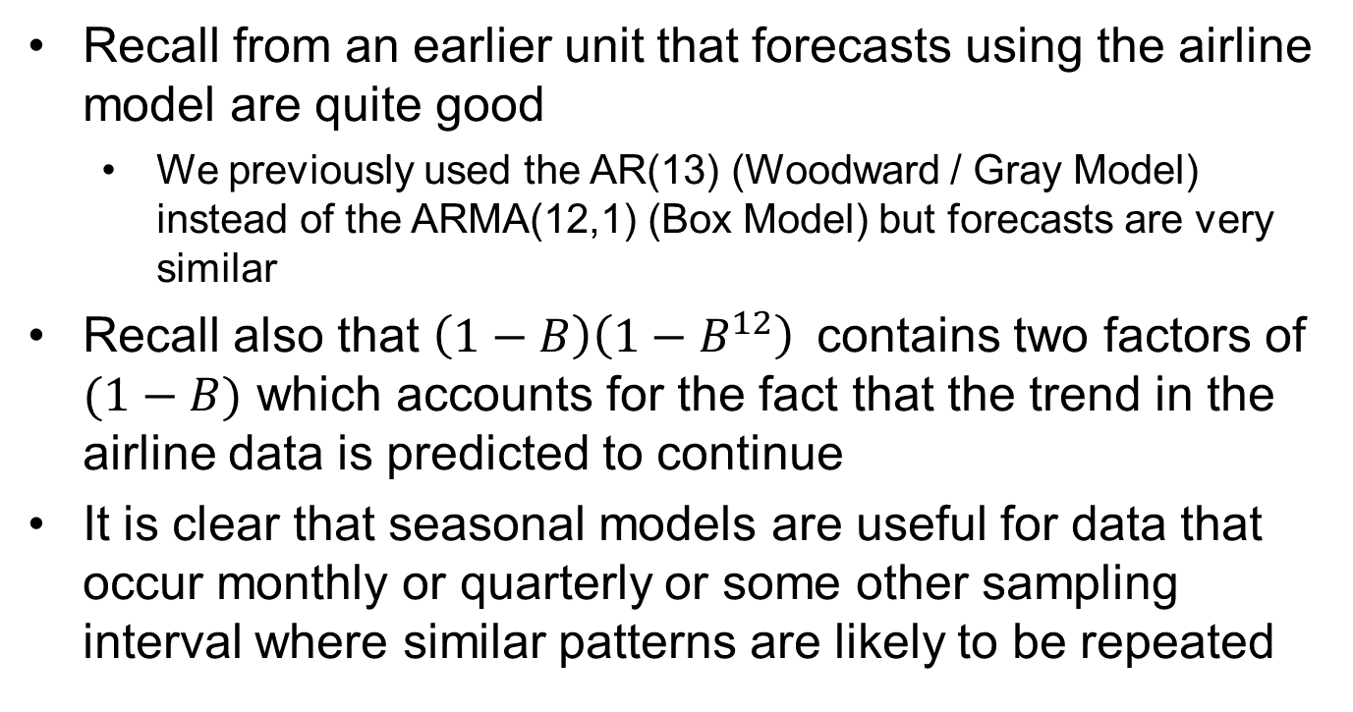
Comments
Recall from an earlier unit that forecasts using the airline model are quite good
We previously used the AR(13) (Woodward / Gray Model) instead of the ARMA(12,1) (Box Model) but forecasts are very similar
Recall also that $\left(1−B\right)\left(1−B^{12}\right)$contains two factors of $(1−B)$ which accounts for the fact that the trend in the airline data is predicted to continue
It is clear that seasonal models are useful for data that occur monthly or quarterly or some other sampling interval where similar patterns are likely to be repeated

Slide 104
Seasonal Models | Example
Pennsylvania Temperature Data

Slide 105
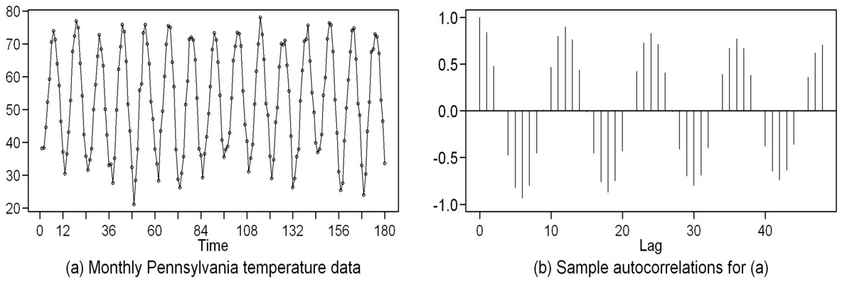
Pennsylvania Monthly Temperature Data
We conclude this section by analyzing another monthly time series
Monthly average temperatures for Pennsylvania over a 15 year period
Again! Use overfit procedure

Slide 106
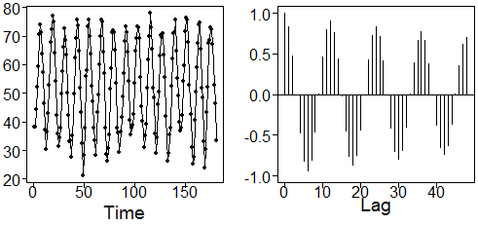
Pennsylvania Monthly Temperature Data
Note:
There certainly seems to be a “seasonal” pattern
Autocorrelations damp slowly
Again! Use overfit procedure

Slide 107
Factor Tables for p=14 and 15 Overfit to Pennsylvania Temperature Data (patemp)
data(patemp) # the data set is available in tswge
est.ar.wge(patemp,p=14,type='burg')
Factor Abs recip System freq
1-1.7267B+0.9971B^2 0.9985 0.0838
1-0.9007B 0.9007 0.0000
1+0.1854B+0.8005B^2 0.8947 0.2665
1-0.8397B+0.7441B^2 0.8626 0.1691
1+0.9827B+0.6948B^2 0.8335 0.3503
1+1.5999B+0.6922B^2 0.8320 0.4557
1+0.4007B 0.4007 0.5000
1-0.3283B 0.3283 0.0000
1+0.1672B 0.1672 0.5000
est.ar.wge(patemp,p=15,type='burg')
Factor Abs recip System freq
1-1.7268B+0.9973B^2 0.9987 0.0838
1-0.8743B 0.8743 0.0000
1-0.8987B+0.7623B^2 0.8731 0.1640
1+0.2200B+0.7559B^2 0.8694 0.2702
1+1.0663B+0.7499B^2 0.8660 0.3556
1+1.6060B+0.7278B^2 0.8531 0.4452
1+0.7830B 0.7830 0.5000
1+0.0141B+0.4368B^2 0.6609 0.2517
1-0.6487B 0.6487 0.0000

Slide 108
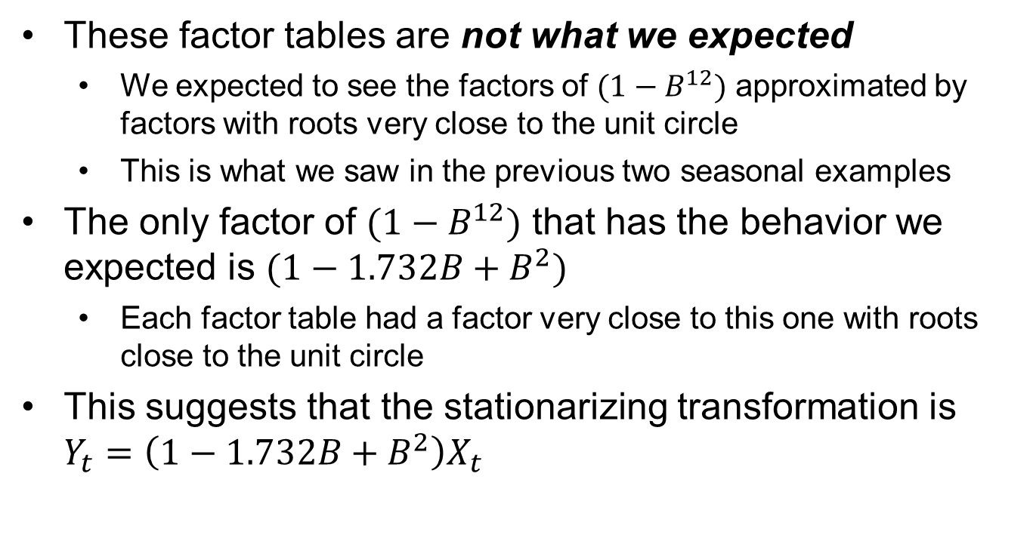
Factor Tables for Pennsylvania Temperature Data
These factor tables are not what we expected
We expected to see the factors of $(1−B^{12})$ approximated by factors with roots very close to the unit circle
This is what we saw in the previous two seasonal examples
The only factor of $(1−B^{12})$ that has the behavior we expected is $(1−1.732B+B^{2})$
Each factor table had a factor very close to this one with roots close to the unit circle
This suggests that the stationarizing transformation is $Y_{t}=\left(1−1.732B+B^{2}\right)X_{t}$

Slide 109
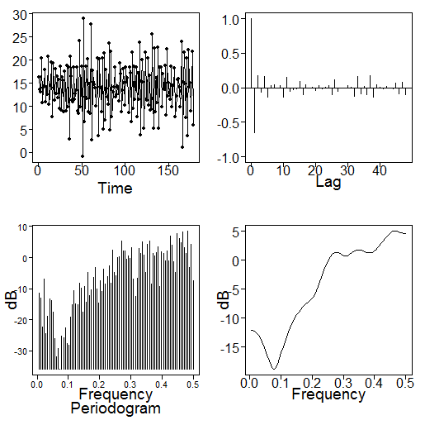

We Transform the Data by $$Y_{t}=\left(1−1.732B+B^{2}\right)X_{t}$$
y.tr=artrans.wge(patemp,phi.tr=c(1.732,-1))
Transformed data
Sample autocorrelations
The transformed data appear stationary
Using aic5.wge with p=0:13, q=0:3, an AR(9) is selected
Using aic5.wge with the same range for p and q and using BIC, an AR(3) is selected
Let’s go with the simpler model

Slide 110
Final Model
Estimating the parameters of the AR(3) model we get
est.ar.wge(y.tr,p=3)
# $phi [1] -1.1425939 -0.8431575 -0.4144801
# $avar [1] 10.76795
mean(patemp) # [1] 52.62667
$\left(1−1.732B+B^{2}\right)\left(1+1.14B+.84B^{2}+.41B^{3}\right)$($X_{t}−52.63)=a_{t},$
$${\hat{σ}}_{a}^{2}=10.77$$
Note:
The above model is an example of what Woodward, et al., 2017, refer to as an ARUMA model
It is a more general nonstationary model that can contain roots on the unit circle that are not necessarily +1
Seasonal models are ARUMA models

Slide 111
Notes
The issue here is that the seasonal behavior is very nearly sinusoidal
It can be explained with a second order factor (with roots on the unit circle and a cycle length of 12)
The other seasonal data sets, for example the airline data, had a non-sinusoidal pattern within the 12 month year
For the airline data November and December are high and January is low, etc.
A pattern, but not sinusoidal
A signal-plus-noise with a sine or cosine signal might also be a good model for these data

Slide 112
Key Point
Do not include 1 – B¹², for example, in the model simply because there is a 12th order nonstationarity or because the data show a period of 12
Or just because you have monthly data
Check the factor tables!!

Slide 114
Signal + Noise Models | Testing for Trend
OLS Method

Slide 115
Fitting Signal-Plus-Noise Models
In our discussion of fitting nonstationary models to data we have considered
ARIMA models
Seasonal models
We next address the topic of fitting deterministic signal-plus-noise models to data

Slide 116
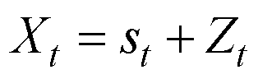
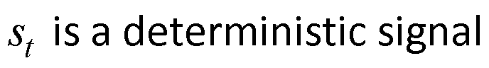
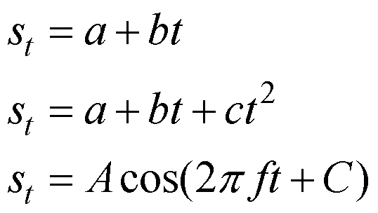
Deterministic Signal-Plus-Noise Models
Example signals:
, C constant

Slide 117
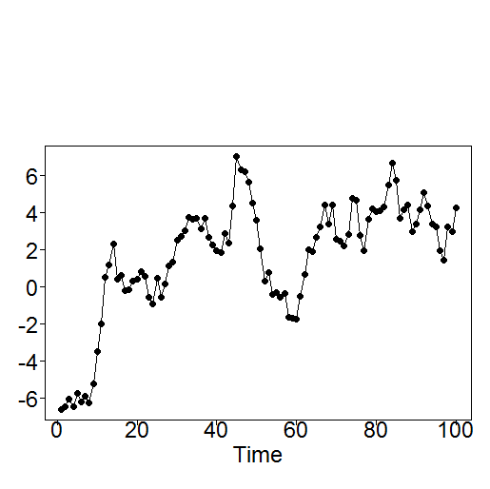

Testing for Linear Trend
Recall: It is difficult to distinguish between random trends and deterministic trends.
We will look at this issue in more detail in this section
Question: Is there a deterministic linear trend component in the data below?
x
Time=t
Note:
It looks like a linear regression problem.

Slide 118


Linear Regression Strategy to Test for Trend
Let t = Time be the independent variable
Let x = $X_{t}$ be the dependent variable
Consider the standard regression model
$${ X}_{t}=a+bt+Z_{t}$$
Conclude there is a trend if $H_{0}:b=0$ is rejected.
Results:
Base R program lm can be used for regression. If
x is the vector of length 100 plotted on vertical axis
t=1:100
The R code:
re=lm(formula=x~t)
summary(re)
produces (among other things) the regression model
$$X_{t}=−2.082+.073t+Z_{t}$$
and $H_{0}:b=0$ is rejected with p<.001.

Slide 119

Conclusion
There is clearly a significant (upward) trend
Check residuals
As good data scientists, we know to check the residuals to see if they are uncorrelated.
Using the R code
z=x –(2.082+.073*t)
we obtain the residual plot below:
Oops!

Slide 120


Obviously the Residuals Are Correlated
Question:
Does that really make a difference? (Or is that just something statisticians worry about?)
Note:
The data set in the previous analysis satisfies the model $X_{t}=0+0∗t+Z_{t}$ where $Z_{t}$ is a realization of length n=100 from the AR(1) model $Z_{t}−.95Z_{t−1}=a_{t}$
That is:
$H_{0}:b=0$is True (and we rejected it dramatically!)

Slide 121

Was This Just a Fluke?
We expect to reject $H_{0}:b=0 \text{about}\text{ 5\% }\text{of} \text{the} \text{time} \text{when} \text{b} \text{=}\text{ 0.}$
Maybe this is just one of those 5%
In order to check this we have run a Mini-Simulation
We simulate several realizations from models $X_{t}=0+0∗t+Z_{t}$ where $Z_{t}$ is from AR(1) models like $Z_{t}−.95Z_{t−1}=a_{t}$
How unusual is it to reject $H_{0}:b=0$(which is true in these simulated realizations)?

Slide 123
Mini-Simulation
Type 1 Error Rate

Slide 124

Mini-Simulation: Using Regression
We consider the model $X_{t}=a+bt+Z_{t}$ where $\left(1−ϕ_{1}B\right)Z_{t}=a_{t}$ where b=0
We test at the .05 level of significance
10 realizations were generated from the model above
For $_{1}=.9, .95$. .975
Realization lengths n=100 and 200
In each case we record the number of times out of 10 we (incorrectly) rejected $H_{0}:b=0$
$$_{1}=.9 _{1}=.95 _{1}=.975$$
n=100 8/10 8/10 9/10
n=200 5/10 8/10 7/10

Slide 125







Realizations from $X_{t}=0+0∗t+Z_{t}$ where $Z_{t}$ satisfies $Z_{t}−.95Z_{t−1}=a_{t}$
Obviously, ${ H}_{0}:b=0$ is true in the above model.
These realizations show “random trends” that are difficult to distinguish from “deterministic trends”
And cause ${ H}_{0}:b=0$ to be incorrectly rejected
Realization we previously analyzed and rejected
$H_{0}:b=0$ with p < .001.
We’ll come back to this

Slide 126

Comments on Simulation Results
The simulations show that using standard regression techniques to test $H_{0}:b=0$ with AR(1) residuals
Where ϕ₁ is close to +1
Ignoring the fact that the residuals are correlated
Results in the null hypothesis are being rejected much more than 5% of the time.
Bottom line
This is a really bad way to test for trend in time series data
You will detect a (deterministic) trend in many cases in which no such trend exists
The test is picking up on the random trends in AR(1) data

Slide 127
Caution:
When we have tests with inflated “observed significance rates”
Then if you find a significant deterministic trend, you don’t have “confidence” that the trend is actually deterministic
The next example illustrates the problems this can cause

Slide 129
Forecasting and False Trend

Slide 130





True model: $X_{t}=0+0∗t+Z_{t}$ where
${ Z}_{t}$ satisfies $Z_{t}−.95Z_{t−1}=a_{t}$
We fit the model: $X_{t}=−2.082+.073t+Z_{t}$
($H_{0}:b=0$ is rejected with p<.001.)
Forecasts vs. actual next 25 data values from “random trend” model
Note: The trend didn’t continue as predicted by deterministic trend model!
oops again!!

Slide 131
Clearly We Need a Better Way to Test for Trend!
Estimation procedures exist for deciding whether a trending behavior in data is due to either a
Deterministic component
or
Random/correlation driven component
or both
These include:
Cochrane-Orcutt
ML techniques
Bootstrap techniques
…
We illustrate the Cochrane-Orcutt method next

Slide 133
Cochrane-Orcutt Method

Slide 134

Cochrane-Orcutt Method
Consider:
$X_{t}=a+bt+Z_{t}$where ${(1−_{1}B)Z}_{ t}=a_{t}$.
Fit a linear regression to the original data and find estimates $\hat{a}$ and $\hat{b}.$
Find ${\hat{Z}}_{t}=X_{t}−\hat{a}−\hat{b}t$ which should be approximately AR(1).
Estimate ${\hat{ϕ}}_{1}$ by fitting an AR(1) model to ${\hat{Z}}_{t}$
Calculate ${\hat{Y}}_{t}=(1−{\hat{ϕ}}_{1}B)X_{t}$, t = 2, …., n
Note that ${\hat{Y}}_{t}=(1−{\hat{ϕ}}_{1}B)X_{t}$=($1−{\hat{ϕ}}_{1}B)(a+bt+Z_{t})$
$=a(1−{\hat{ϕ}}_{1}$)$+bt−b{\hat{ϕ}}_{1}(t−1)+\left(1−{\hat{ϕ}}_{1}B\right)Z_{t}$ $=c+bt_{{\hat{ϕ}}_{1}}$+$g_{t}$, where $t_{{\hat{ϕ}}_{1}}=t−{\hat{ϕ}}_{1}(t−1)$.
where $c=a(1−{\hat{ϕ}}_{1}\text{)}\text{, } t_{{\hat{ϕ}}_{1}}$ $=t−{\hat{ϕ}}_{1}\left(t−1\right),$and $g_{t}=\left(1−{\hat{ϕ}}_{1}B\right)Z_{t}$
light board
Why did we do that?

Slide 135






Logic behind the Cochrane-Orcutt Method
We transformed:
$X_{t}=a+bt+Z_{t}$where ${(1−_{1}B)Z}_{ t}=a_{t}$.
To the new model:
same slope
⇒ $Z_{t}{{=(1−_{1}B)}^{−1}a}_{t}$
${\hat{Y}}_{t}=(1−{\hat{ϕ}}_{1}B)X_{t}$=$c+bt_{{\hat{ϕ}}_{1}}$+$g_{t}$, where
$c=a(1−{\hat{ϕ}}_{1}\text{)}\text{, } t_{{\hat{ϕ}}_{1}}$ $=t−{\hat{ϕ}}_{1}\left(t−1\right),$ and $g_{t}=\left(1−{\hat{ϕ}}_{1}B\right)Z_{t}$
Let’s look at $g_{t}$
?
new dependent variable
new constant
new independent variable
$g_{t}=\left(1−{\hat{ϕ}}_{1}B\right)Z_{t}$
$$g_{t}=\left(1−{\hat{ϕ}}_{1}B\right)Z_{t}=\left(1−{\hat{ϕ}}_{1}B\right){{(1−ϕ_{1}B)}^{−1} a}_{t}$$
$$Z_{t}$$
The two factors: $\left(1−{\hat{ϕ}}_{1}B\right)$ and $\left(1−{\hat{ϕ}}_{1}B\right)$ nearly cancel each other out
i.e. $g_{t} { a}_{t}$ so $g_{t}$ should be “nearly uncorrelated”
light board
Finally: Test $H_{0}:b=0$ in this “new” model
Using standard regression methods

Slide 136
Cochrane-Orcutt Test
Test H₀: b = 0 using the test statistic
Note:
On the next slide we discuss the performance of the Cochrane-Orcutt method on simulated data
light board

Slide 138
Cochrane-Orcutt in R (Orcutt Package)

Slide 139


Cochrane-Orcutt Test in R (in Orcutt Package)
install.packages("orcutt")
library(orcutt)
x = gen.sigplusnoise.wge(100, b0 = 0, b1= 0, phi= .95, sn = 21)
t = seq(1,100,1)
df = data.frame(x = x, t= t)
fit = lm(x~t, data = df)
summary(fit)
cfit = cochrane.orcutt(fit)
summary(cfit)

Slide 140

Mini-Simulation: Using Cochran-Orcutt
We consider the model $X_{t}=a+bt+Z_{t}$ where $\left(1−ϕ_{1}B\right)Z_{t}=a_{t}$where b=0
We test at the .05 level of significance
10 realizations were generated from the model above
For $_{1}=.9, .95,$ .975
Realization lengths n=100 and 200
In each case we record the number of times out of 10 we (incorrectly) rejected $H_{0}:b=0$
$$_{1}=.9 _{1}=.95 _{1}=.975$$
n=100 2/10 4/10 4/10
n=200 1/10 2/10 2/10
Note: Results are much better than those using simple regression
Still higher than 5% ??

Slide 141
More Extensive Cochrane-Orcutt Simulation Results
b = 0 (i.e. null hypothesis of zero slope is true)
1000 replicates generated from each model
Observed significance levels for tests H ₀ : b = 0
50 18.4 27.2 37.2
100 16.0 20.0 28.4
250 8.0 12.4 17.6
1000 4.8 8.4 9.6
Conclusion: Cochrane-Orcutt has significance levels inflated over 5%

Slide 142
Comments about Inflated Rejection Rates
Recall:
Type I error rate: Probability of rejecting the null when it is true.
We typically run hypothesis tests controlling the Type I error rate to be small (commonly α =.05)
We want there to be a small chance of rejecting the null when it is true
In our case we want there to be a small chance of declaring there is a deterministic trend (b ≠ 0) when it is actually zero
i.e. when the only trending in the data is correlation-based random trends

Slide 143


Testing for Trend: Summary
$$X_{t}=a+bt+Z_{t}$$
It’s a difficult problem when $Z_{t}$ has a positive correlation structure
That produces “random trends”
And are difficult to distinguish from “deterministic trends”
Ignoring the correlation structure in the residuals and running a standard regression analysis is a very bad idea
The Cochrane-Orcutt technique helps adjust for the correlation structure but still rejects the null hypothesis more often than it should
Other methods such as ML (used by SAS) have similar problems with inflated significance levels
See Woodward, Bottone, and Gray (1993) for more discussion of these issues

Slide 145
Bonus Material

Slide 146
Bootstrap Method
Woodward, Bottone, and Gray (1997). Journal of Agricultural, Biological, and Environmental Statistics (JABES), 403-416.
These authors devised a method for improving the observed significance levels
Based on a bootstrap = based technique
Bivin: let’s talk

Slide 147
Simulation Results
b = 0 (i.e. null hypothesis of zero slope is true)
1000 replicates generated from each model
Observed significance levels for tests H ₀ : b = 0
5.9
6.4
3.8
4.1
8.1
5.3
5.1
3.8
10.0
7.6
6.4
6.1
50 18.4 27.2 37.2
100 16.0 20.0 28.4
250 8.0 12.4 17.6
1000 4.8 8.4 9.6
Black: Cochrane-Orcutt
Red italics: Bootstrap

Slide 148
Final Remarks
We have discussed the problem of detecting a deterministic trend in time series data
Even if a deterministic trend is detected, caution should be exercised for all but short term forecasts
Unless there is sufficient evidence that current conditions exist into the future
This is essentially the extrapolation problem in the time series setting
We have not discussed the issues involved in testing for deterministic components other than linear trends.
For example, cosine trends can be difficult to distinguish from cyclic nonstationary and near nonstationary behavior

Slide 149


